Slide 1
Olympic Games: The Events

Slide 2
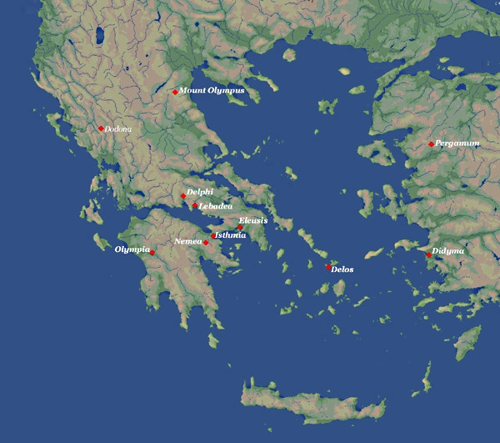

Slide 3
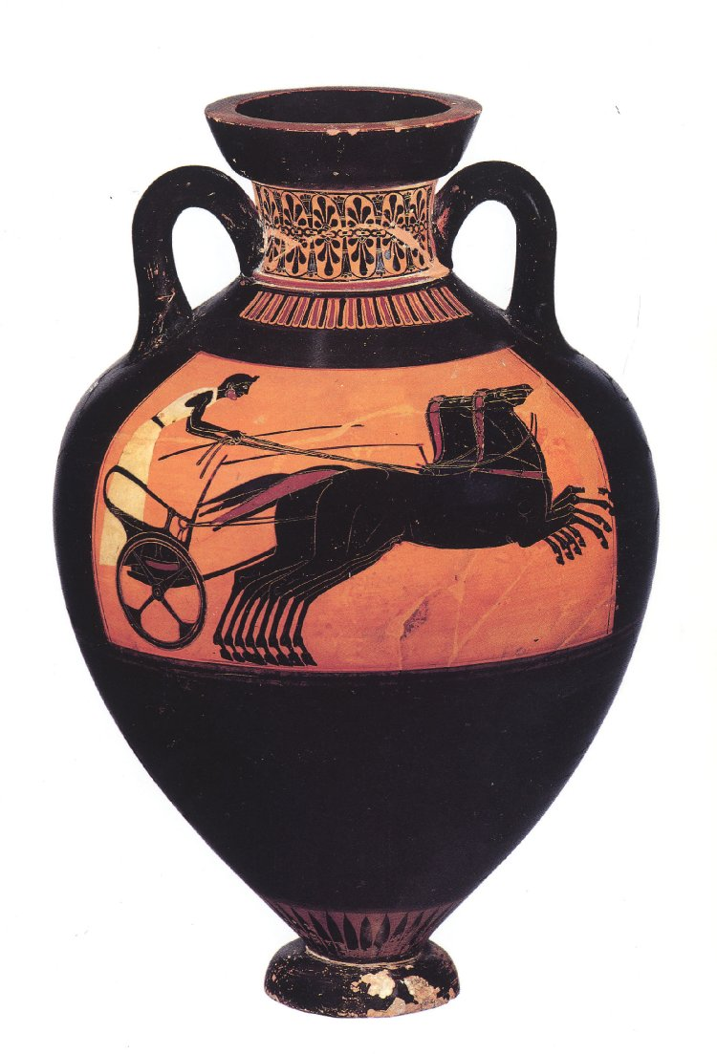
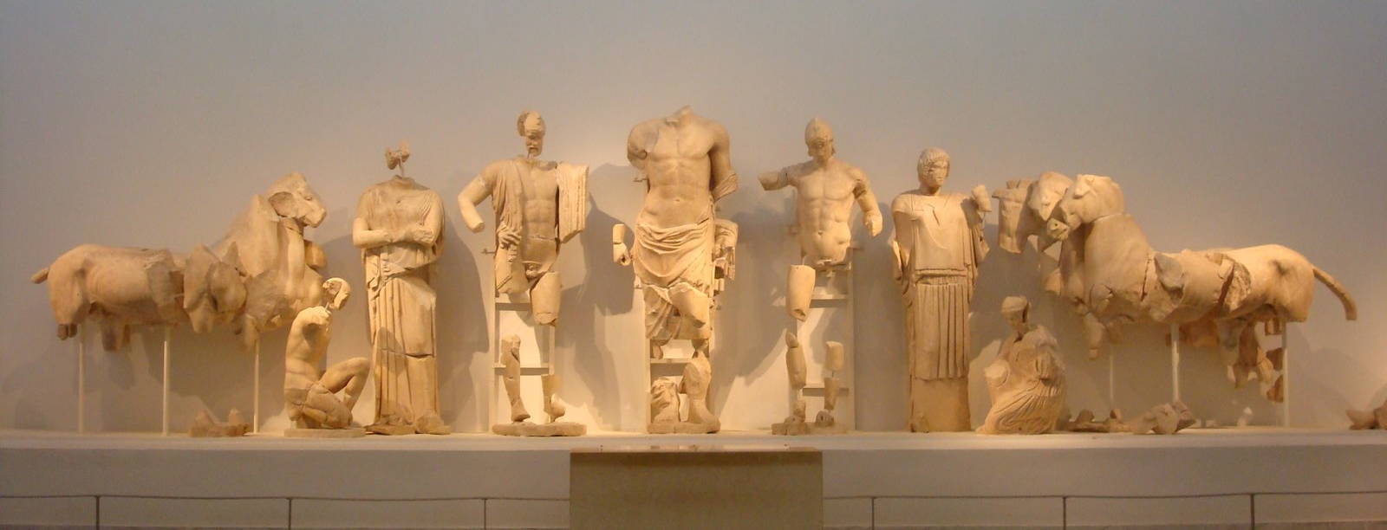
Chariot Racing

Slide 4
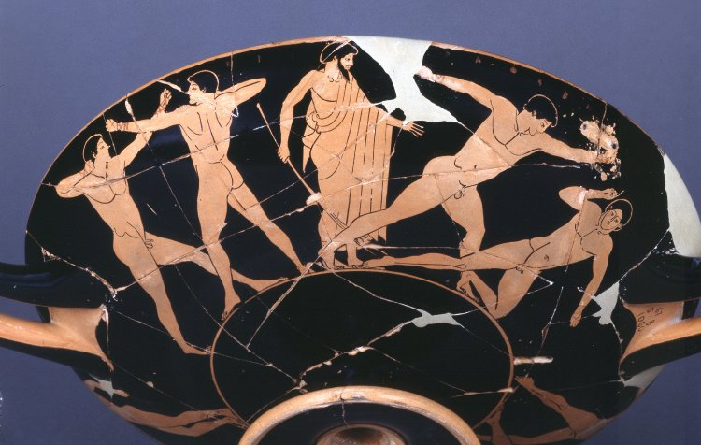
Boxing

Slide 5
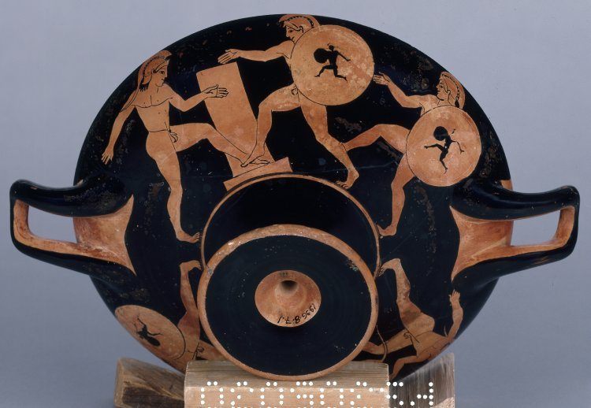
Running in Armour

Slide 6
Running

Slide 7
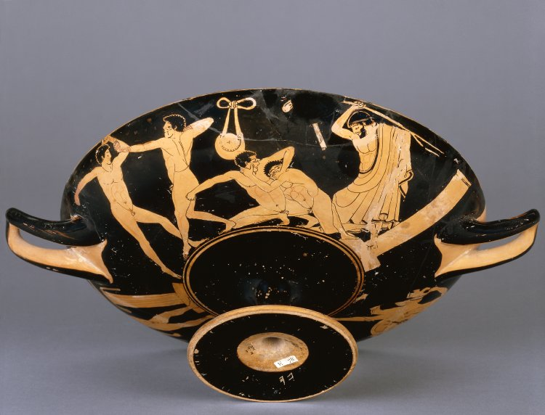
Wrestling: Pankration

Slide 8
Discus

Slide 9
Javelin

Slide 10
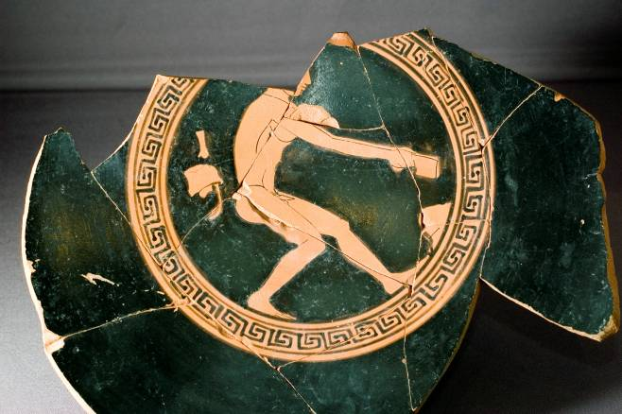
Long Jump

Slide 11
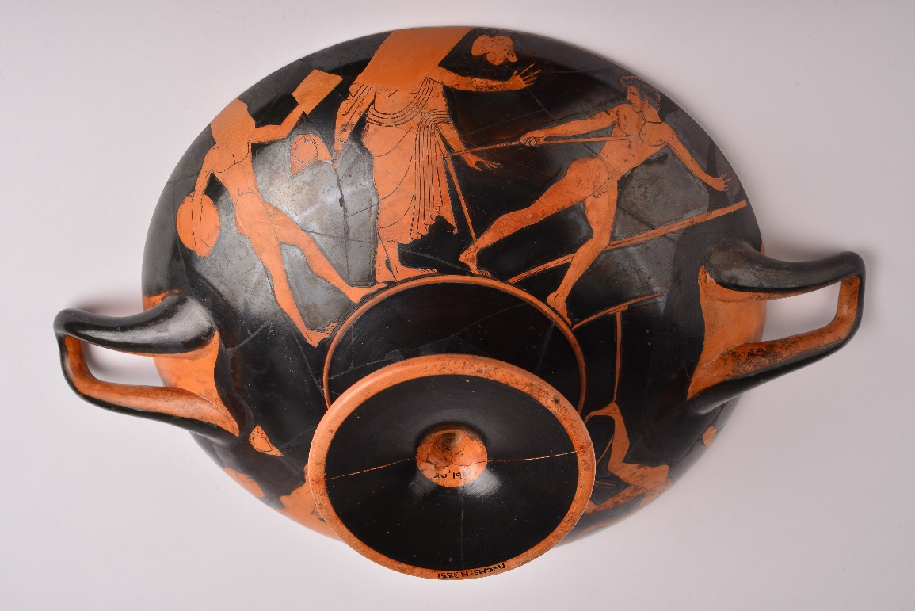
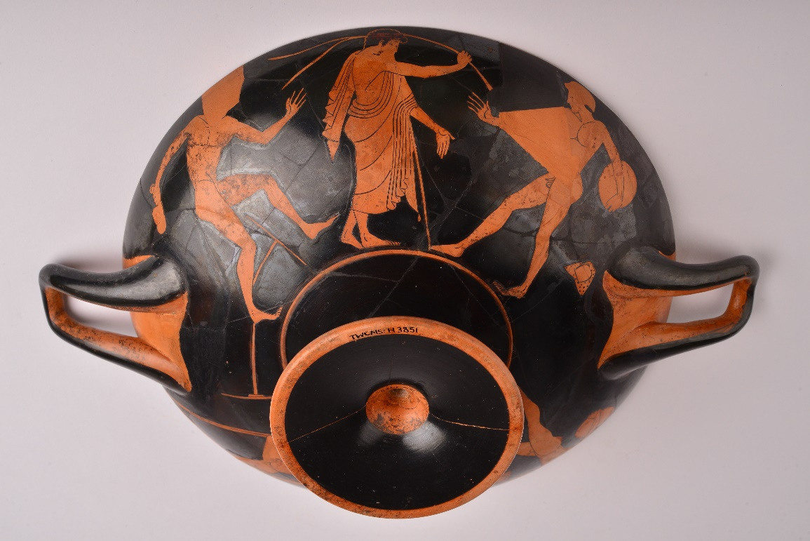
Pentathlon
Running
Wrestling
Javelin
Discus
Long jump

